Slide 1
Zekelman school
Notes:
Hi, we are going to present a digital marketing campaign from a project management standpoint

Slide 2
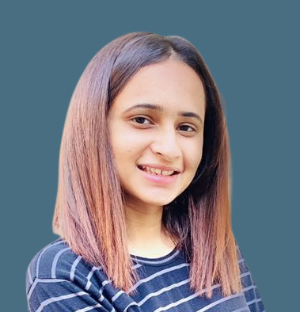
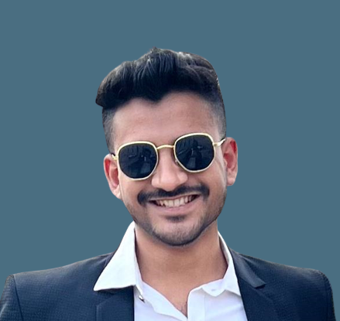
Group #12 : Team
Amit Sharma
0794488
Suhail Ahmed 0789949
Rajvi Mehta
0788372
Harshil Patel
0791261
Jayraj Radadiya
078
Notes:
Our team members are Me, Kartik, Rajvi, Harshil and Farzin

Slide 3
Introduction
Company
Problem
Solution
DigitallyLearnt LLB., A newly founded digital educational content creator in the field of digital marketing, has developed products that have passed the quality examination and received optimal feedback from initial and limited launch.
Scale up the revenue and reaching more audiences is digitally promoting the product.
Sell more copies of its digital content to go further in the course of the growth and gain profits.
Running the first widespread digital marketing campaign for the current products .
This campaign will try to target potential customers on these popular platforms.
Aim to increase the exposure of the products' brands and convince new customers to purchase the product.
Notes:
We are a digital content creator that produce online contents in the areas of digital business and commerce
One of our products has received good feedbacks and reviews from customers
so, we spotted a need to promote our product through digital marketing campaign which
will be the first widespread campaign of the company.
The objective is to attract potential customers to buy our product and enhance our company’s brand image

Slide 4
Problem Statement:
Company
Problem
Solution
DigitallyLearnt LLB., A newly founded digital educational content creator in the field of digital marketing, has developed products that have passed the quality examination and received optimal feedback from initial and limited launch.
Scale up the revenue and reaching more audiences is digitally promoting the product.
Sell more copies of its digital content to go further in the course of the growth and gain profits.
Running the first widespread digital marketing campaign for the current products .
This campaign will try to target potential customers on these popular platforms.
Aim to increase the exposure of the products' brands and convince new customers to purchase the product.
Notes:
We are a digital content creator that produce online contents in the areas of digital business and commerce
One of our products has received good feedbacks and reviews from customers
so, we spotted a need to promote our product through digital marketing campaign which
will be the first widespread campaign of the company.
The objective is to attract potential customers to buy our product and enhance our company’s brand image

Slide 5





Project Process Groups
Monitoring & Controlling
Planning
Initiating
Executing
Closing
Notes:
In this presentation we will talk through different process groups from initiating and Closing of this project

Slide 6

Stakeholders
The main objective is to collect and conduct a detailed and relational analysis of data pertaining to all current students enrolled in the program.
streamlined and comprehensive study for understanding student’s data and concerns.
Stakeholders
Platform for raising and addressing their concerns regarding Living and Acedemics
Benefits
Management
work on a practical problem and learn various technology platforms and understand Data pipeline
Students
Team
Notes:
Three documents needed for this group: Business case, project charter and Stakeholder register.
Our project’s Stakeholders include:
Marketing department, Software and development department, Customer care, customers, and higher management.
- We use Power & support grid and Interview stakeholders to determine the business values important to the stakeholders
The Business Values include Revenue and Brand value of the company and product
We use business value measures (KPI) to assess business value delivery.
Our main KPIs for this project are:
Number of Impressions,
Number of clicks,
Number of purchases and the
costs associated with each of these metrics
(cost per impression, cost per click and Cost per acquisitions)
As it is an Internal Project:
We as Project Manger with the help of our Sponsor create our statement of work and then create Charter based on that
By having the Statement of work which is a description of the project (as we call it solution here )
& use the Benefit management plan (What is the benefits , when they will be realized , how they measured)
We combine those two documents as a comprehensive Business Case
& By considering our EEFs (As we mentioned before) & OPAs (financial data, other projects, some historical info ) our Project Charter has borened
Project Charter:
Project description & authorizing
Our commitment for the campaign
-
To create project charter we decide to use our Marketing consultant help & as UX team for some data gathering about the market preference then we Use some Meeting with different department to make our charter as logical as possible

Slide 7




Data
SURVEY DATA
Demographic
Ease of living
Academics
1
HOW:
Primary data collection was conducted through surveys.
The collected data is stored in an Excel online file. To automate the transfer of data from Excel to Google Cloud, we used Microsoft Power Automate to connect the data to Google Drive and facilitate the transfer process.
WHAT:
Our data collection process consisted of three parts: demographics, ease of living, and academics.
Demographics: collected information about student backgrounds and personal characteristics.
Ease of Living: focused on students' experiences with housing, transportation, and other aspects of student life.
Academics: gathered data on students' academic performance and experiences.
These three parts provided us with a comprehensive overview of students' experiences and feedback.
2
3
WHY:
To understand student’s opinions, attitudes, and behaviors
To evaluate programs and services
To improve communication and engagement
This Photo by Unknown Author is licensed under CC BY-NC-ND

Slide 8
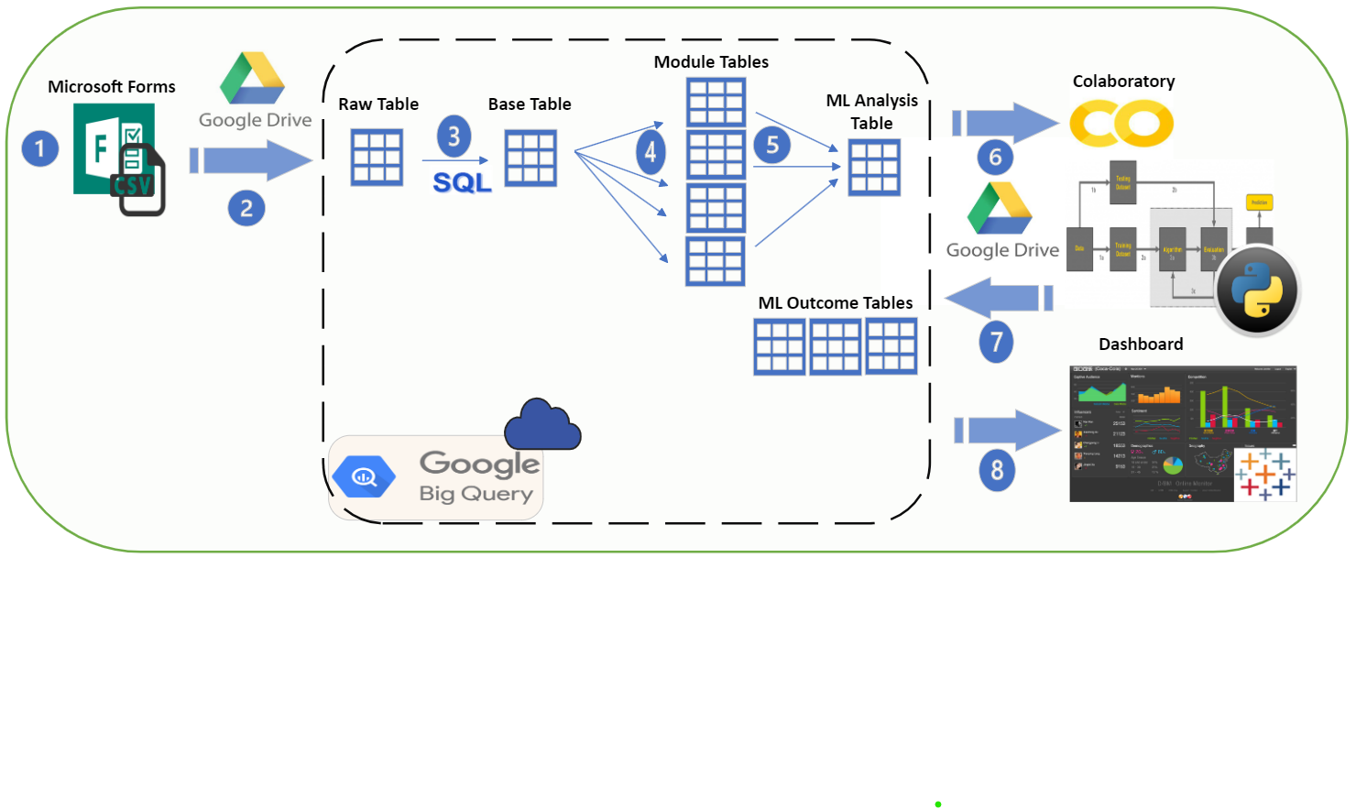
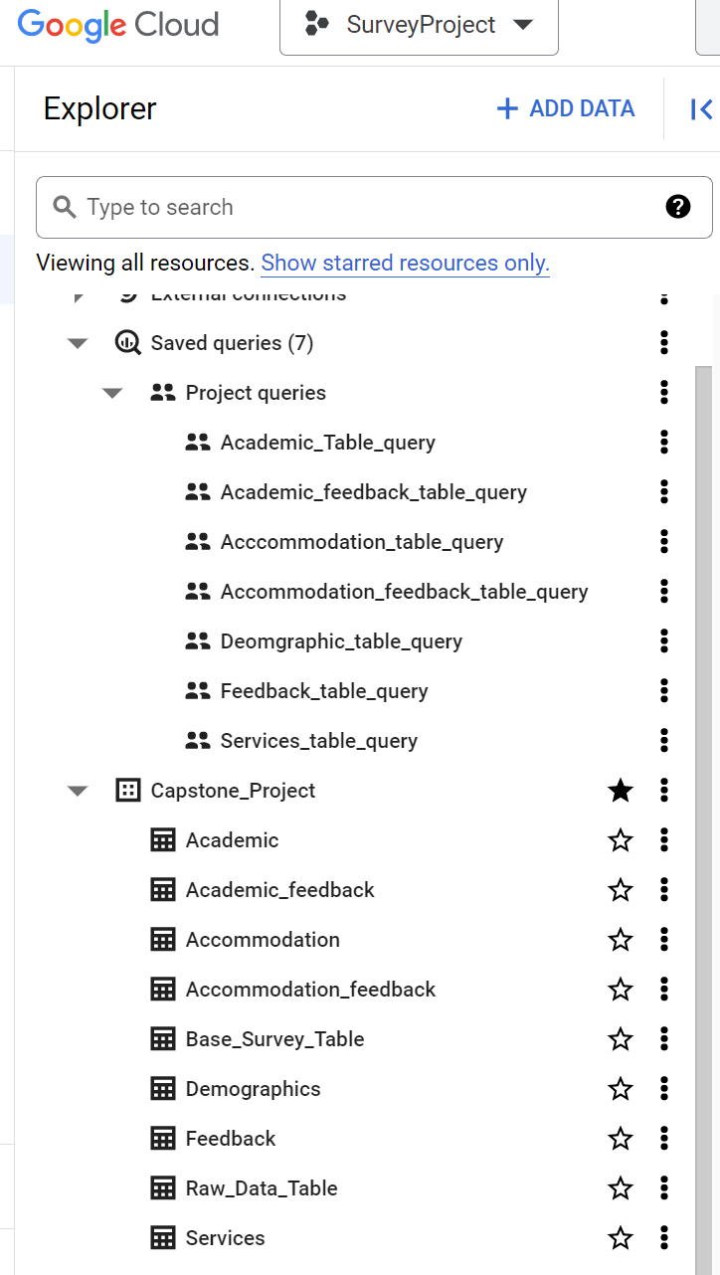








Methodology
Data Intake Phase - Power Automate
Database Ingestion - .CSV to Big Query (through Drive)
Data Movement – DB architecture (inside the Database)
DB to Google Colab (for ML)
Data Stored back to DB
Data to Dashboard (in Tableau)

Slide 9




Timeline
05
Final Dashboard
04
Survey 2
03
Dashboard 1
Today
ML and Dashboard
02
Data Work
& Pipeline Integration
06
Final Report
Data
Assessment
Dashboard Work
Survey 2
Work
01
Survey 1
Machine Learning
Data work
Business Problem Formulation
Data Collection
Data Pipeline/DB
W1
W2
W3
W4
W1
W2
W3
W4
W1
W2
W3
W4
W1
W2
W3
W4
January2023
February 2023
March 2023
April 2023
Notes:
This RACI matrix is based on all the activities in the project that have been planned

Slide 10





Progress (till now)
STEP 8
STEP 7
Data
Pipeline
STEP 6
Survey setup &
Publishing it
ML
Algorithm
STEP 5
Research & study
Initial
DB
setup
Problem
Statement
definition
STEP 4
STEP 3
Data
Assessment
Stakeholder
meeting
STEP 2
STEP 1

Slide 11
Challenges and Solutions:
Project Management Plan
Project Documents
Project Milestones
Project Schedule
Risk Register
Requirement Gathering
Project Communication
…
Validate & Control
Scope
Control Cost & Schedule
Control Quality
Control Resources
Monitor Communications
Validate
Scope
Update
Change Request
Change log
Lesson Learned Register
Updated Work Performance
Change Request
Issue Log
Notes:
The task of controlling and monitoring the progress is assigned to the Campaign manager
Campaign manager is asked to communicate the necessary information based on the RACI matrix and Communication plan to respective parties and stakeholders.
We need to ensure that all related documents such as Project management plan, Schedule , etc., are kept updated according to the change log
Tracks, reviews and regulates the progress and performance of the project and identifies corrective action or changes if needed
Also we Monitor stakeholder Engagement
Monitor & Control Project Work
Perform Integrated Control Change
Validate Scope
- at the end of any major deliverables
- We check for the completeness of the deliverables
for each deliverable this validation performed by PM, Sponsor and related key stakeholders
We do that in each Sprint review (based on our communication doc)
In each sprint review the stakeholders Examine and Test the deliverables
Control Scope
After each Scope Validation, we updated “work performance “ , Then in this step we compare it with our baseline
If any changed is required we handle it through Change management process and creating Change request & after approved or reject we update the Change Log document.
Control Schedule
- Iteration burndown chart , we compare our planned backlog with actual results (as our approach is agile)
Control Costs
By using Data Analysis techniques & Earned Value Analysis
We might need some change request in this part
Control Quality
We use check lists for controlling Quality of any deliverables
Also in test campaign steps we will test the performance & quality of our designed campaign
Control Resource
For example In the running part of the campaign there is some risk that our infrastructure could not handle the load of traffics, so there might be some resource & supply damage. In these situations We will define this problem, find the roots of the problem and choose a suitable solution to solve and check if it solve or not.
As we use Agile approach, part of daily meetings will assign to the barriers and obstacle that team is encounter, so the approach is to solve them as soon as possible and before the end of the sprint with minimum effect to the sprint value.
Monitor Communications
-
Monitor Risks
Identify new risks
We continuedly monitor for emerging risks and change the status of identified risks
Control Procurements
Monitor Stakeholder Engagements

Slide 12
Conclusion and Future Work:
Close Project
Project Review
Finalize Contractual Agreements
Subcriptions of ads & promotion channels
Lesson Learned Register
Update Documents
Lesson Learned
Archive info
Asset Update
Final Transition
Transfer the results to Sale & Customer Service
Releasing Staffs
Releasing Other Resources
Stakeholder Satisfaction measurment
Final Report
Notes:
These are some of the Final reports that needed to be done in this group:
Main campaign Assessment analytics
Sales report from sales department
Customer care report from customer services
Some examples of Lessons learned in this projects are:
Objectives were clearly defined and quantified
We had Flaws in scheduling that we should learn not to repeat
use of Slack conversation threads was effective int course of the project
For Asset Update:
The time of project staff is freed, and they can return to their day-to-day activities until a new project need arises

Slide 13
Thanks!
Do you have any questions?

